Slide 1
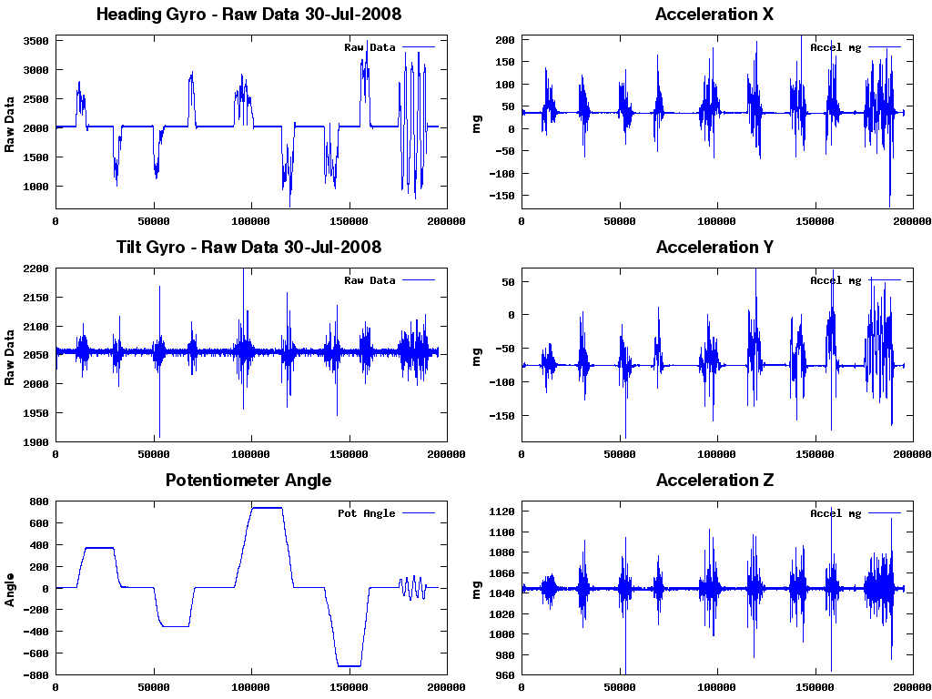
Introduction to Data Processing

Slide 2
Overview
Introduction
General Tips
Some of my tools
Set of commandline tools (zsh, git, mvim …)
matlab
ipython, R
Case Study: Workshop Scenario

Slide 3
Disclaimer
Data analysis/processing is a very broad term
A lot of different definitions
A lot of different tools
In this tutorial I show you what works for me:
The methodology
Some useful tools
Most important:
Have fun playing with data!

Slide 4

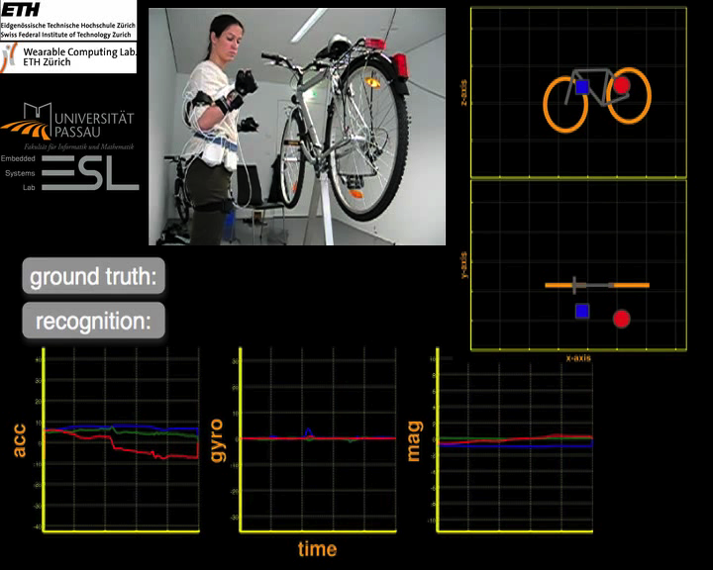
Kai Kunze

Slide 5
Research
As researcher your product is not data or code …your product is knowledge
Empirical science uses data and code to obtain knowledge
good research is about reproducibility
Notes:
http://www.theexclusive.org/2012/08/principles-of-research-code.html

Slide 6
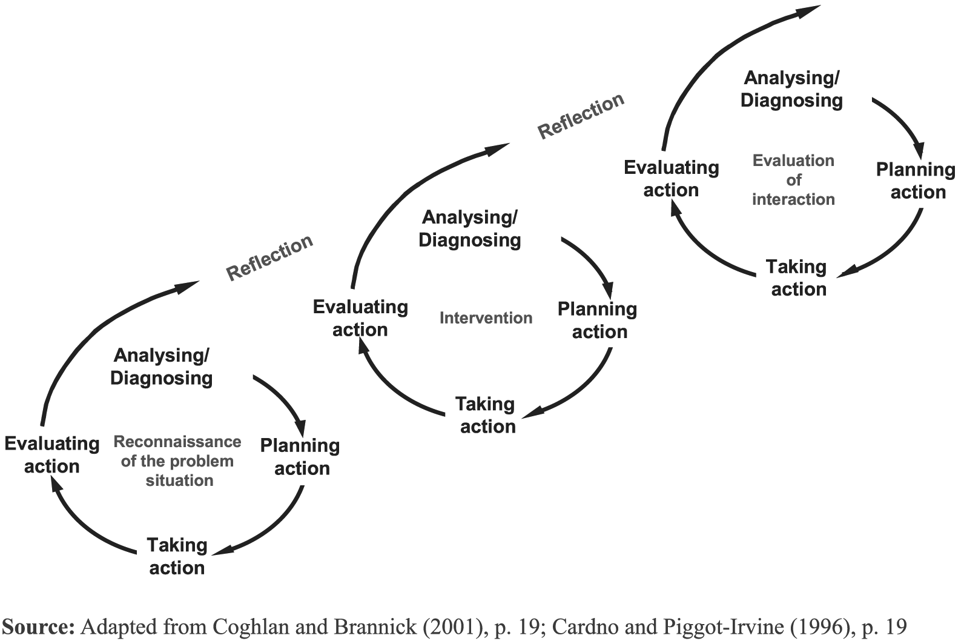
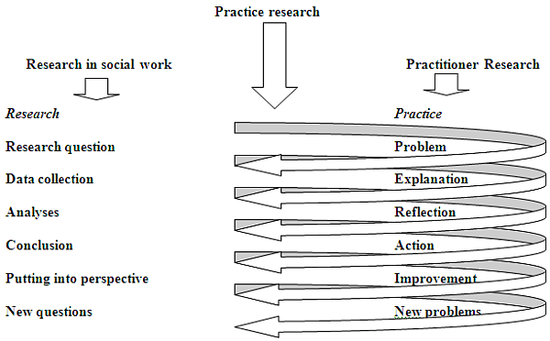
Research “life” cycle
Idea -> record

Slide 7
Getting data …
Standard datasets
http://contextdb.org
Own Experimental Design
Difficult !! Don’t underestimate the design
Some good starting points (for UI design experiments, yet also valid for other designs)
http://ocw.mit.edu/courses/electrical-engineering-and-computer-science/6-831-user-interface-design-and-implementation-spring-2011/lecture-notes/MIT6_831S11_lec14.pdf
http://ocw.mit.edu/courses/electrical-engineering-and-computer-science/6-831-user-interface-design-and-implementation-spring-2011/lecture-notes/MIT6_831S11_lec15.pdf

Slide 8
How I handle data …
Separate code from data
One data set, multiple types of analysis
Have separate directories for data
Suggestion: input, working, output
input: never changes!
working: calculated features, processing steps
output: classification results etc.
NEVER change the raw data directly
NEVER do changes by hand to the data …

Slide 9
Sample Project directory
My_project
data
Working
Input
Output
Code
Matlab
Python
C
README.md
My_Data
EEG
Working
Input
Output
Face_rec
My_EEG_project
papers
code
demo
test
README.md

Slide 10
Use Source Control (for code, docs …)
Use a distributed version control system
My favorite: git
I use it for everything … (except DATA)
papers
My website
Every text file
Text files are your friends ☺
Don’t use git for data (use .gitignore file to exclude it)

Slide 11
Save frequently and backup
Save everything to disk frequently
Features you calculated
Data preprocessing steps
Your models, your results
Disk-space is cheap, use it
Use naming conventions:
For example one of my working directories:
Working/2012-12-02-features-accel-sw100.mat
Dropbox is nice
if the data is not too large and sensitive (privacy!!)
works for code

Slide 12
On tests, timing …
Test the data + code as early and often as possible
Work with input /output files
General tests used for:
Prototyping language (perl, python …)
Demo implementation in faster language (C, C++ …)
Estimate the timing of your methods
Paper deadline driven

Slide 13
Tips
Use folder structures (with docs, tests)
Use Version Control
Save everything frequently (intermediate steps)
Easy to execute part of the analysis (modular setup)

Slide 14
Pick the right tool for the right purpose …
Remember we want to produce knowledge
There are a lot of data processing/ analysis software out there:
Matlab, mathematica, maple, S, Strata
Octave, Sage, R
Libraries in c, java, pyhton, ruby, javascript, perl
Every software comes with advantages and disadvantages!

Slide 15
Tools I use …
Commandline tools
screen, cat, grep, sed, head, tail, awk, find, xargs, sort, wc …
Zsh, vim
I use YADR (for mac):
http://skwp.github.com/dotfiles/
For the initial data processing
Matlab, python (ipython, scipy …) http://www.enthought.com
For most plots: R
For demos, production code:
Depends, whatever does the job
A good knowledge of C is very helpful ☺
Notes:
Stole the example from: https://github.com/hmason/ml_class

Slide 16
Case Study: Workshop Scenario
Let’s assume you need to build a prototype for a project
Support of a worker during an assembly scenario
Requirements:
You should recognize the following tasks:
hammering, screw driving, sand papering, sawing
The classifier should run on an embedded platform
Linux –arm, C implementation
How do you start?

Slide 17

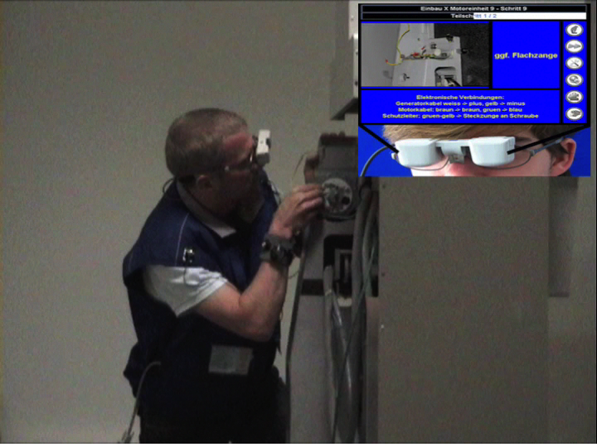
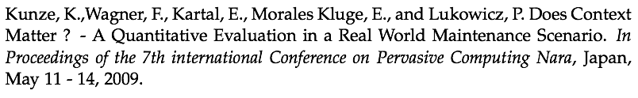

Slide 18

Case Study: Workshop Scenario

Slide 19
Plotting in R
Excel is not nice to do plotting ☹
I don’t know how to program in R
Really
However, it does not matter ☺

Slide 20
Rapid prototyping for demos …
Processing
java
Node.js /ruby on rails
Javascript:
d3.js (for http://contextdb.org )
http://square.github.com/cubism/

Slide 21
Further References
Data analysis, machine learning, dsp
https://class.coursera.org/dataanalysis-001/
https://www.coursera.org/course/dsp
https://www.coursera.org/course/ml
Visualization
http://cs171.org
Help
http://stackoverflow.com
http://stats.stackexchange.com

